Slide 1
SEND Information Report 2026-2027
Publish date: September 2025
Review date: September 2026
This report should be read alongside our SEND Policy
Click here to go to the contents page.

Slide 2
















Contents
Key Contacts
Approach to Assessing and Reviewing
3 Waves of Inclusion
Needs we support
Identify Need
Parental Involvement
Pupil Involvement
Transitions
Teaching Approaches
Staff Training
Supporting Extra-curricular
Supporting Wellbeing
LAC and SEN
Complaints
Worcestershire Local Offer
Appendices - FAQs

Slide 3
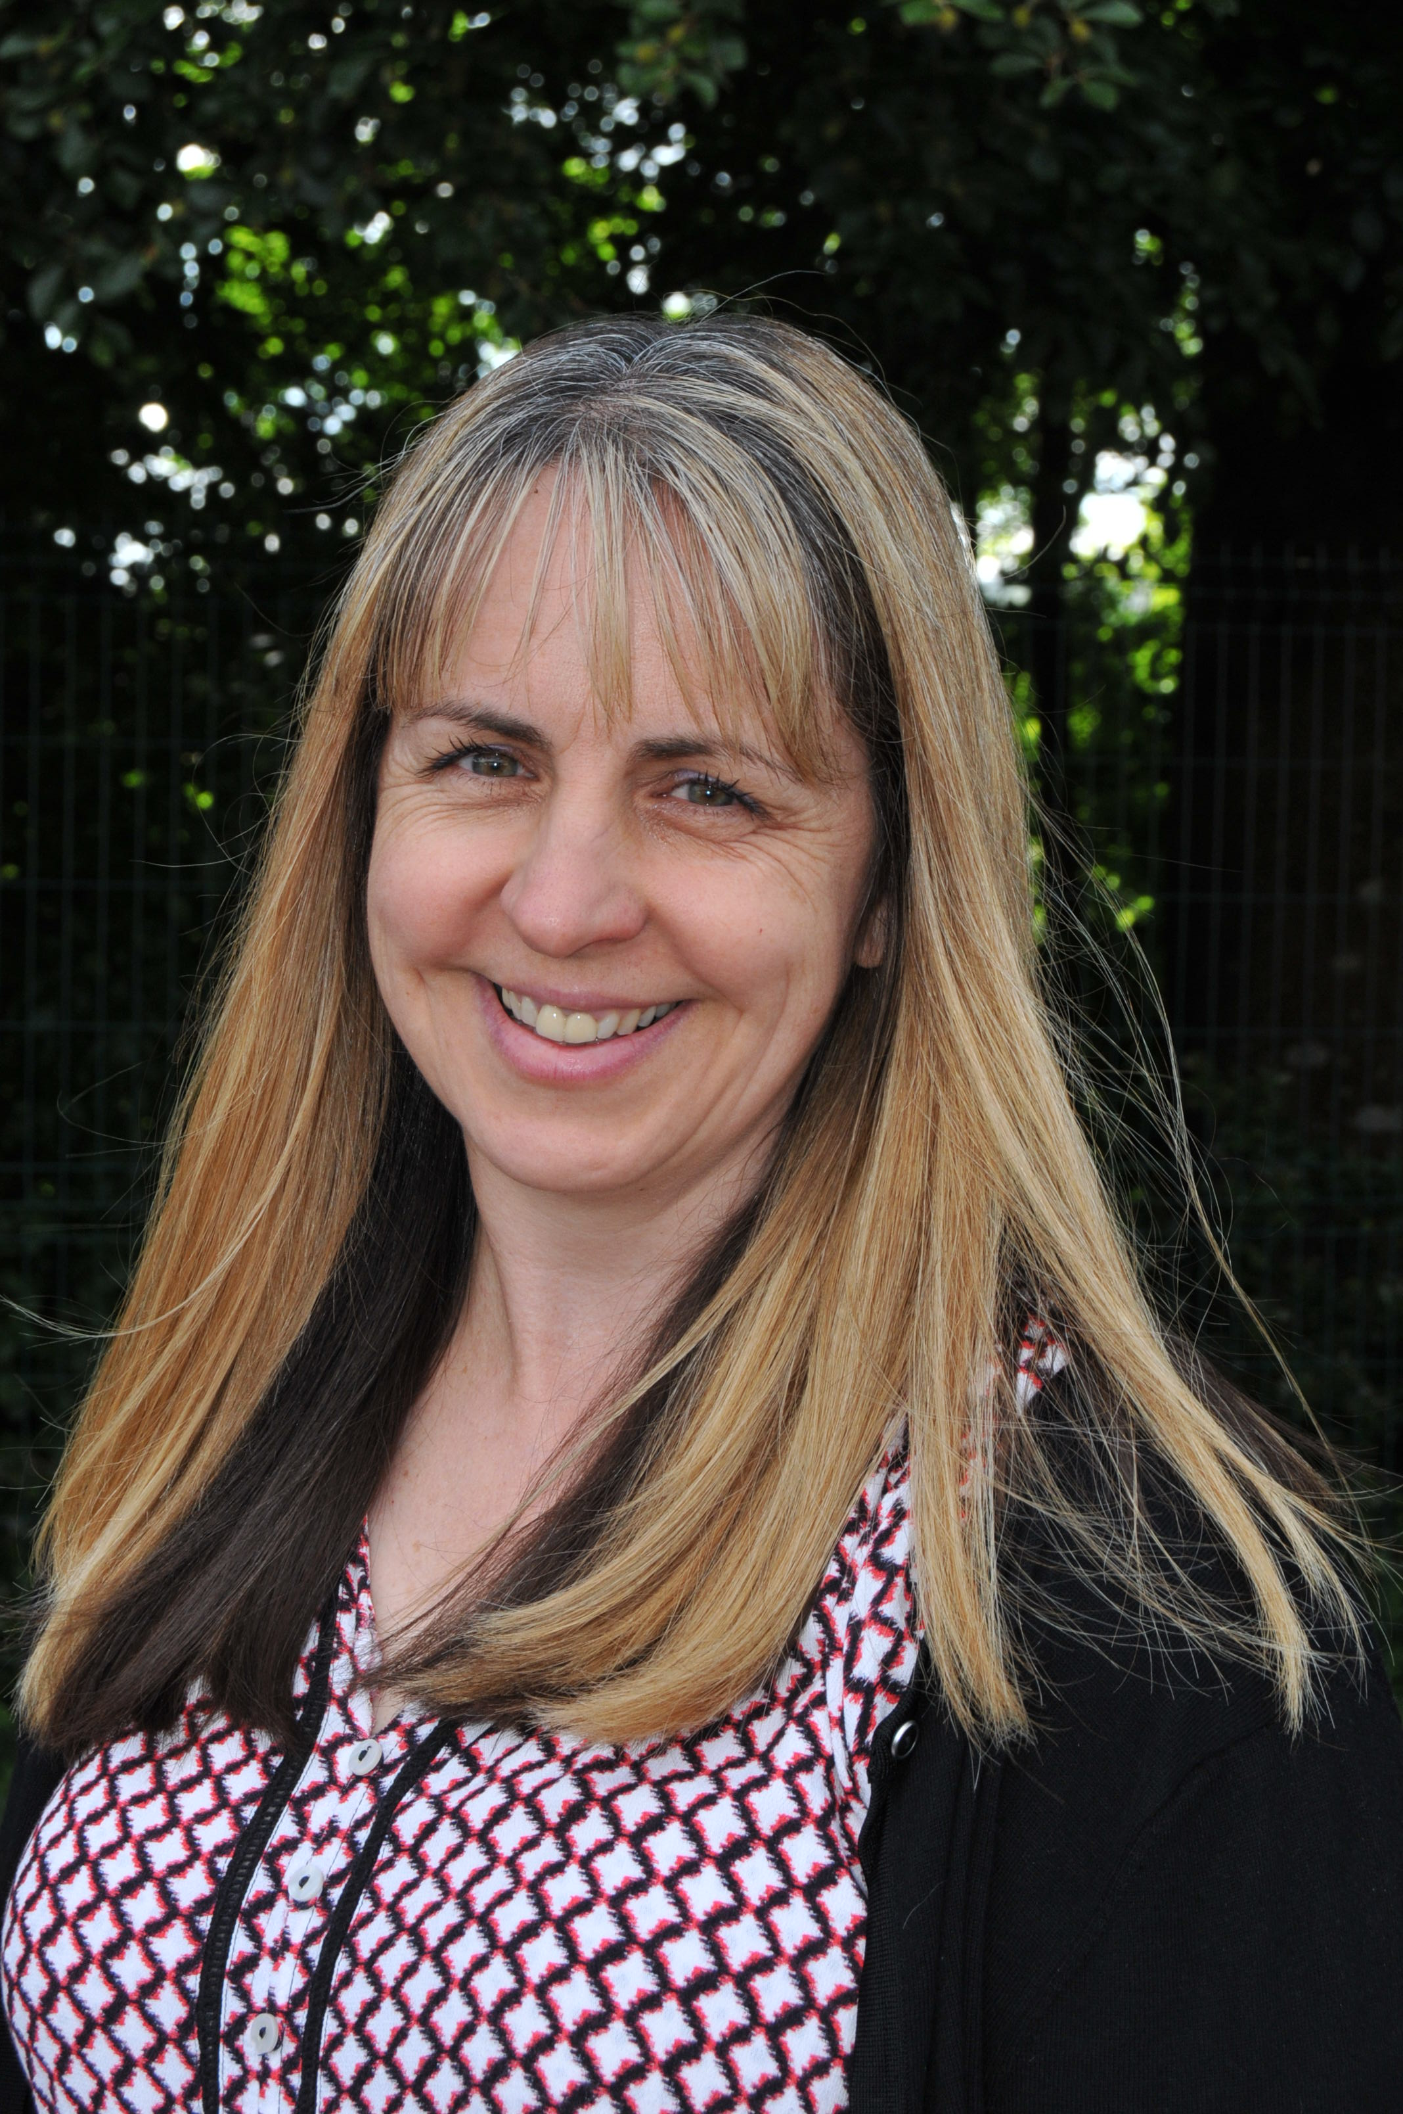
Key Contacts
In the first instance, if you have any concerns that your child might have a Special Educational Need or is finding learning difficult you should contact your child’s class teacher. You can email admin@okehamptonprimary.org.uk
Our Special Educational Needs Coordinator (SENDCo) is Jacqui Dart
jdart@dmatschools.org.uk
The role of the SENCo involves ensuring that:
teachers understand a child’s needs
teachers are trained in meeting those needs
the quality of teaching for students with SEND, and provision across the school is efficiently managed.
Working with wider professionals to support children with SEN
Our trust parent ambassadors are Beth Batembeau, Chrissie Read and Vicky Hopkins. They can be contacted through the school office.
School Phone Number: 01837 82566
Okehampton Primary School
Glendale Road
Okehampton
EX20 1JB
admin@okehamptonprimary.org.uk

Slide 4
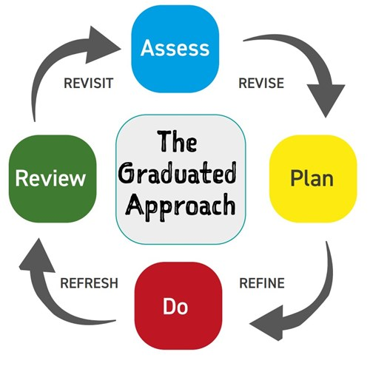
Graduated approach to supporting pupils with SEND
Assess
What do we know about this learner? Observe, gather information and data, be curious, ask questions, when are they successful? What are they good at?
Plan
What is the barrier causing the most impact on engagement in learning? What would help with this? What do they need to do/know/have in order to be more successful?
Do
Implement the plan with the learner and family and relevant staff
Review
Review the quality, effectiveness and impact of the provision and support. How well did it work? What aspects worked? What hindered success?
Click here for more information about the process and who does what at each stage.

Slide 5
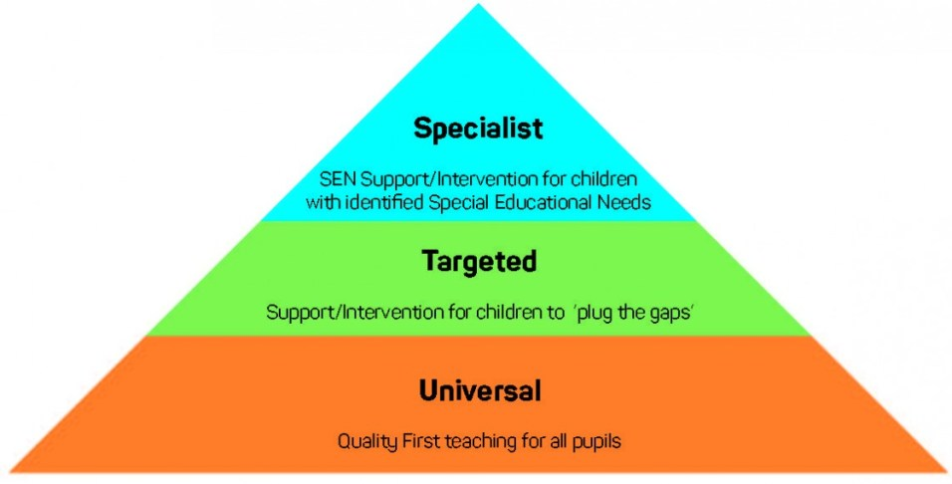
We use the following model when planning support. Each pupil will fit somewhere into one of these stages.
Universal – what we offer for all children.

Slide 6
We cater for the four Broad Areas of SEN.
These include:
Communication and Interaction (C&I) | Cognition and Learning (CL) | Social, Emotional and Mental Health Needs (SEMH) | Sensory and/or Physical (SP)
Speech, Language and Communication Need (SLCN) Autism (ASC / ASC) | Moderate Learning Difficulties (MLD) Severe Learning Difficulties (SLD) Profound and Multiple Learning Difficulties (PMLD) Specific Learning Difficulties (SpLD) SpLD – dyslexia, dyspraxia and dyscalculia | Attention Deficit Disorder (ADD) Attention Deficit Hyperactivity Disorder (ADHD) Attachment Disorder (AD) | Hearing Impairment (HI) Multi-sensory Impairment (MSI) Visual Impairment (VI) Physically Disabled (PD)

Slide 7
Working together to identify Special Educational Needs
Working with external agencies.
This could include a health diagnosis from a doctor such as Autism or ADHD
Working with parents/carers.
If parents/carers have a concern about their child we will listen and investigate.
Identifying SEN
Working with previous schools/settings.
We talk to previous schools to understand what support has been put in place to help individuals learn.
Teachers in school.
Teachers noticing that a pupil is working below the expected level.
Screening
We can screen children who may have a speech and language difficult
Children’s are defined as having a Special Educational Need when they require provision that is additional to and different from that which is available to all children.

Slide 8
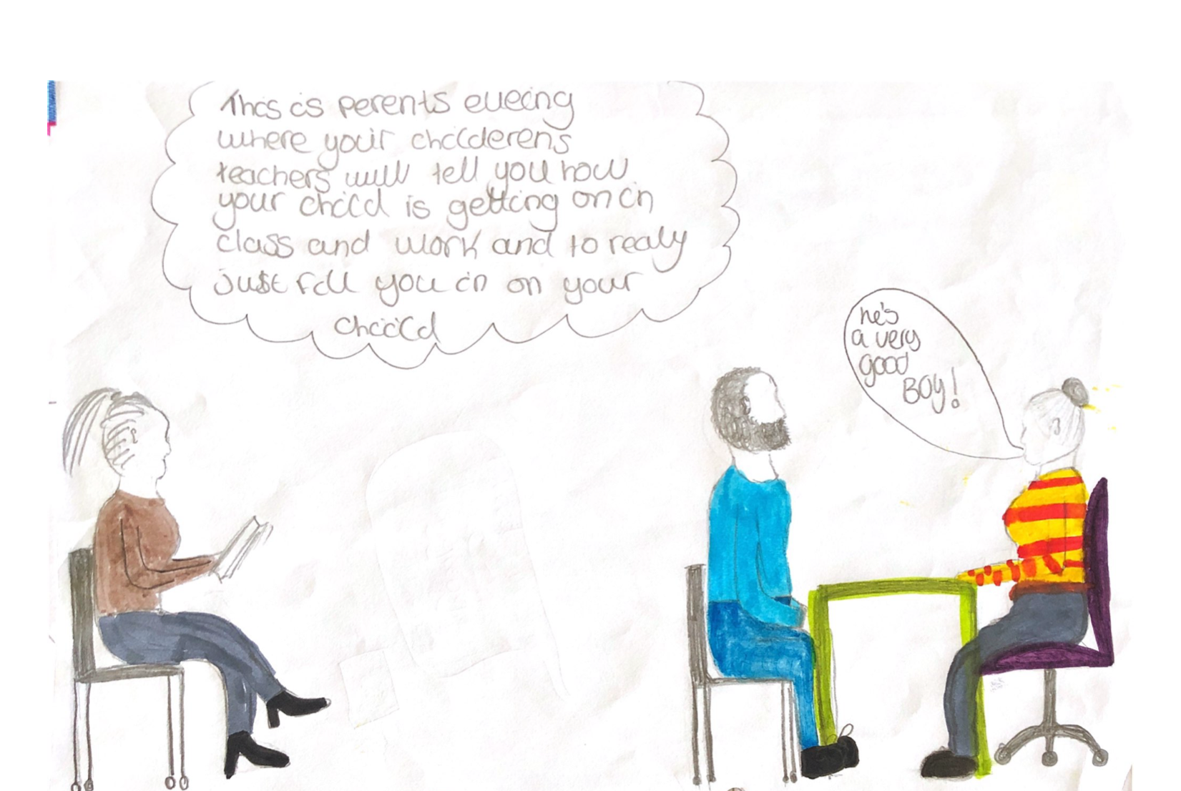
How we involve parents/carers.
We strongly believe it is vital that parents/carers are involved with the support given and progress made by their child.
Parents are very much part of the individual learning plan yearly cycle. If you child has a learning plan class teachers will meet with you and discuss these once a term outside of the normal parents evening offer.
Parents/Carers invited to EHCP annual reviews
Class charts will help parents have regular access to praise points
Termly SEND parent forums
Termly SEND clinics available with the SENDCO
SENDCO works closely with the school parent support advisor
Termly SEND newsletter

Slide 9

How we involve pupils with SEN in their education
'I can talk to an adult at school if I am worried about my learning.'
‘I talk a TA about my learning’
I love going in the Nest this helps me be calm.
Peer massage is my favourite.
'I have a learning passport that all teachers can see, so they know how to support me.'
I can use Chrome book when I have to do lots of writing.
I like working in a small group
As part of our termly learning plan reviews, the view of the pupils is recorded and included in the review and next steps planning.

Slide 10
Supporting transitions - Starting in Year 7
Transitions are carefully planned with the involvement of a transition leader at Okehampton college, Year 7 SEND lead, Okehampton college SENDCO and our school SENDCo.
This includes having initial discussions with the team when the children are in year 5. This gives Okehampton College the best idea of how they can best support children and have some consistency in support. These discussions carry on early in year 6 when a transition package is planned for each individual child with additional needs.
The college SEND team will visit when the children are in year 5 and then again once the children go in to year 6.
Year 5s and Year 6s from local primary schools are invited to visit Okehampton college for taster days to prepare them for starting secondary school.
Sports activities are planned early on, so children are familiar with the school and are ready when the transition arrives.
Okehampton College Transition Leader, Head of Year 7 and the Year 7 team work hard with the SENDCo to ensure a smooth transition from primary to secondary school.
When a child leaves our school we will always ensure information is passed on to their new school, in accordance with GDPR and Data Protection legislation.

Slide 11
Supporting transitions mid-year
If your child is starting at Okehampton Primary School during the academic year, we make sure that they are welcomed and feel safe and included the same as everyone else.
We have a variety of methods to support starting with us. These include:
Calls with parents/carers to really understand the context of each individual child. | Call the previous / current school to discuss any concerns. This allows us to make a head start on support.
A tour of the school with parents/carers. | Taster days at Okehampton Primary School.
Having a peer buddy on their first days | A Pupil Voice interview after their first few weeks to check in.

Slide 12
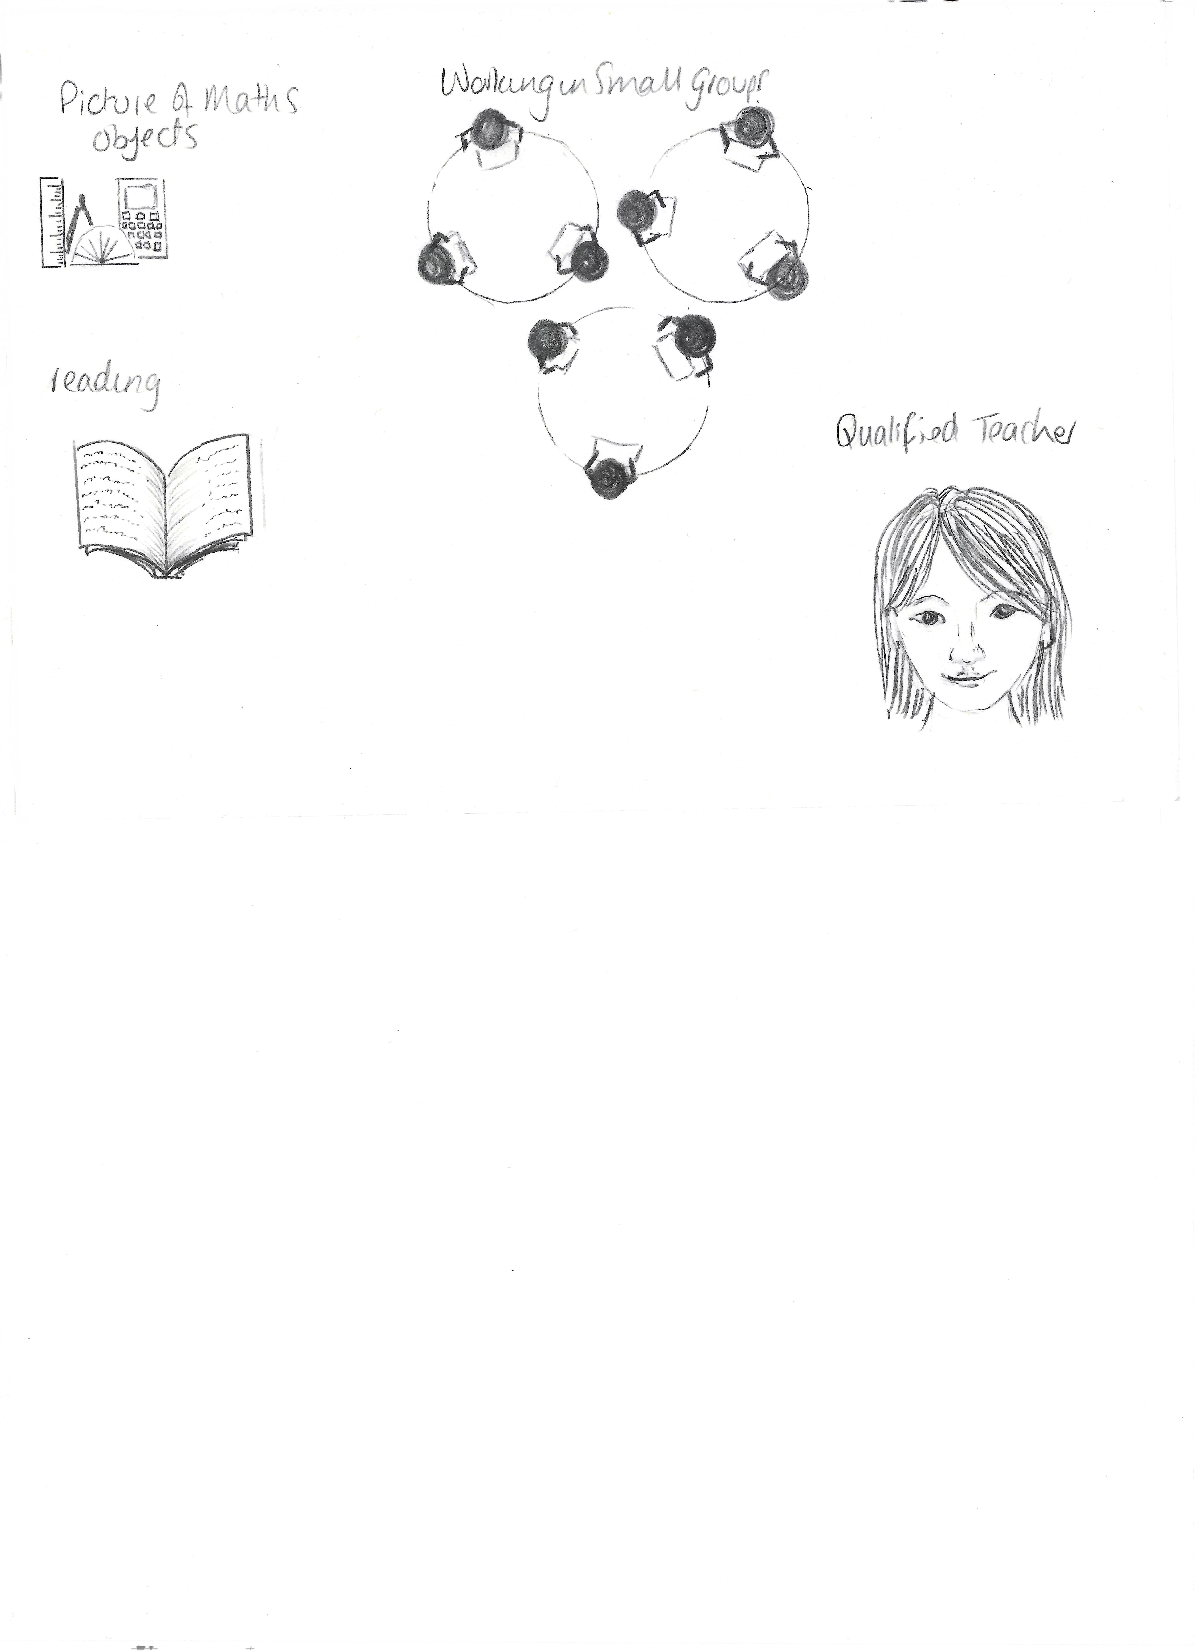
Examples of how we make every lesson count for all learners
A qualified teacher who is able to teach pupils with SEND. support tasks at different levels for all children, so everyone can understand.
Having alternative homework activities
Some children might require different equipment or learning strategies, this can include different coloured paper or bigger text to support their reading.
Pre-teaching new subject vocabulary and highlighting key vocabulary at the start of lessons.
Supporting the teaching and learning of pupils with SEN
A whole school focus on reading - including supporting the lowest 20% with specific reading strategies, such as Read Write Inc phonics, Lexia and FreshStart
Visual prompts and visual timetables used across the school.
Retrieval practice to help revisit key learning or specific vocabulary.
Some classes have additional adults to help support the learning of all children. Sometimes this is 1:1 or it could be in small groups. We never assign one adult to any particular child, even if they have an EHCP.
Using visuals and objects to represent concepts in Maths

Slide 13
What training have our staff had in order to support pupils with SEN?
Staff members receive regular, ongoing up-to-date training on SEND.
The SENCo has the following qualifications:
BA (Hons) Education with QTS
National Award in SEN Coordination Postgraduate Diploma (NASENDCO)
Adaptive Teaching (the process of including all children’s needs in learning) is an integral part of our school’s values.
Our Teaching Assistants will continue to access ongoing training and support.
Raise attainment
All children prepared for the next year of education with the skills and knowledge they need
Eradicate gaps
Equitable provision and outcomes for our most underserved young people
Drive belonging
All young people, staff, and communities feel connected, heard and valued
All members of staff have received the following training:
Yearly updates on pupils with SEND and the methods to use to support them
SEN Snippets in the weekly staff news led by the SENDCo
Trauma informed practice
Supporting children through a relational approach
Writing an effective Individualised Learning Plan (ILP)
Supporting specific Literacy difficulties
Supporting children who are neurodiverse
Autism Educational Trust training updates across the year
Our SENCo works alongside individual teachers to support with their specific needs.
New teachers and teaching assistants have a one-to-one meeting with the SENCo in their first week.

Slide 14



How we encourage pupils with SEN to complete extra-curricular activities
Everyone has access to all areas of life at Okehampton Primary School. This includes extra-curricular activities. Where needed reasonable adjustments are made, which will be done in discussion with the lead teacher of the club, the SENDCo and parents/carers. Please, refer to our Accessibility Plan for more detail.
We offer a range of extra-curricular activities and clubs which change across the year.

Slide 15
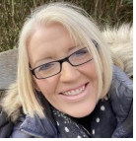
Supporting Wellbeing
We are very lucky to have been able to set up a therapeutic space within the school. We call this the ‘Nest’. Many children access the nest across the week. Your child has been given a time slot to visit 'The Nest' in school. This is run by Christine Ramoutar where the aim is to support children with a variety of social, emotional and mental health needs. Within the nest they aim to:
ensure children can name and recognise their emotions and teach them how to self regulate if they find this difficult
teach calming techniques
model desired behaviours (eg. how to manage disappointment) and demonstrate positive relationships
encourage listening skills and social skills
support children with anxiety and help build confidence and self esteem
assess sensory needs
support children who are finding it difficult to access school
support children who have experienced trauma due to home life, loss, bereavement, family break-up etc.
We do all of this in a safe and calm environment, using lots of sensory play, board games, sensory massage , baking, circle time etc.
Christine Ramoutar – SEMH/Pastoral Lead

Slide 16
Supporting pupils with SEN who are a Looked After Child (LAC)
If a child is LAC and has SEN, the SENCo will review Personal Education Plans (PEP) with the designated teacher.
If a pupils has SEN, but does not have an EHC Plan, the support required will be in the child’s PEP and Care plan.
If appropriate, the Virtual School Head will be invited to comment on proposed SEN support as part of our Graduated Approach.
The SENCo and designated teacher will work together to ensure that the whole-school is working together to ensure that the right support is given.
Our LAC Designated Teacher is Mr Smith msmith@okehamptonprimary.org.uk
Information on Devon’s virtual school support

Slide 17
What to do if you have a complaint
Parents/carers who wish to make a complaint should follow the 3 Stage process summarised below.
Stage 1 – Informal
Parents/carers should discuss any concerns they have with their child’s teacher.
You can contact also complain to the SENDCo via email on jdart@dmatschools.org.uk
Stage 2 – Written
Where the complaint has not been rectified you will be required to complete a Complaint Form, available on the DMAT website. At this stage the complaint will be investigated by the Principal or the Executive Principal.
Stage 3 – Complaint Panel
If you are unhappy with the outcome you can contact the DMAT Complaints Coordinator to request a complaint panel to be set up within three academy weeks of the outcome of Stage 2.
For more detailed information please read our Complaints Policy, available at https://dartmoormat.org.uk/contact-us/
or contact the office for a paper copy.
If you have a complaint about an EHCP you should contact a SEN and Disability Tribunal. Please contact the SENDCo, on how to do this.

Slide 18
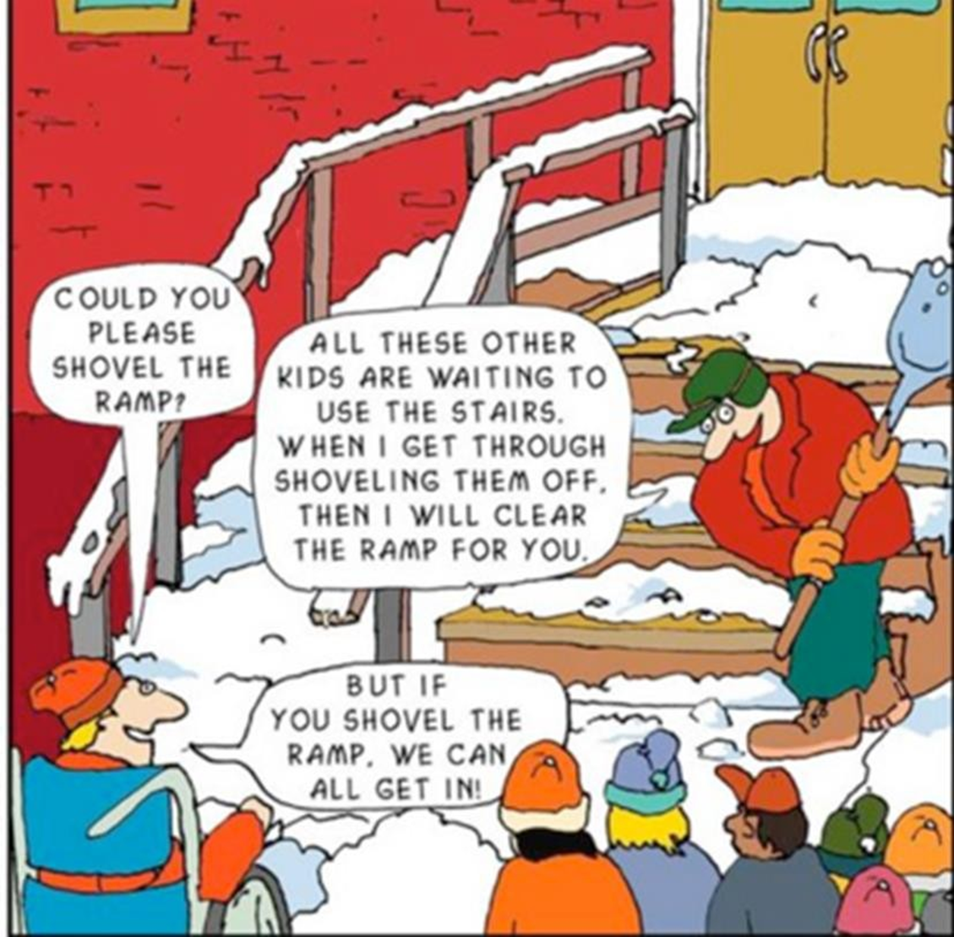

Devon’s local offer
You can find Devon’s SEN Local Offer online at
https://www.devon.gov.uk/education-and-families/send-local-offer/about-send-and-the-local-offer/what-is-the-send-local-offer/
Use the link to see Devon’s Ordinarily Available Inclusive Provision (OAIP). This describes the inclusive provision and practice that all Devon schools, early years, and post 16 settings should be able to provide for all children and young people, including those with SEND, from within their own resources. This will support all children and young people to attend, engage and thrive in their educational setting.
It describes approaches, provision and practice that is ‘helpful to all, harmful to none and crucial for some’.
Click here for Devon’s OAIP

Slide 19
Frequently Asked Questions
How will all the teachers know what my child needs?
SEND support information to be shared with every teacher who teaches your child.
When the SENDCo updates it; all of the teachers see it.
How often will I hear from school?
In each year, you will receive one report and two parents’ evening. Pupils with an EHCP will have a termly meeting with the SENCo. Pupils on SEN Support will have termly contact with the class teacher to discuss individual learning plans.
How will I know how my child is getting on?
In each year, you will receive a data report, a full report and a parents’ evening. Pupils with an EHCP will have a termly meeting with the SENCo. Pupils on SEN Support will have termly contact with the class teacher.
Will my child have a 1:1 Teaching Assistant (TA)?
We are unable to provide 1:1 TAs to all children with SEN or an EHCP.
Who should I contact if I am worried my child has a Special Educational Need?
First, would be the class teacher, who can let you know if there are already provisions in place within school. They will then talk to the SENDCo and feedback to you.
If you have any questions that we have not answered, please email Miss Dart(SENCo) on jdart@dmatschools.org.uk
How will teaching be adapted to support my child?
We pride ourselves on getting to know your child and know what strategies will help them feel safe in school and learn. This means that we create learning plans from scratch to meet the individual needs of your child.

Slide 20
Communication Interaction Resource Base (CAIRB)
Okehampton Primary School has a CAIRB on site to support the needs of learners with an Education, Health and Care Plan for Communication and Interaction needs.
The CAIRB is a support to mainstream education and does not provide a special school experience.
Admission to the CAIRB is made via Devon County Councils 0-25 Team. Only pupils with an EHCP will be considered for one of the eight places available.
A full-time place at The CAIRB will provide:
An educational experience in line with that of other primary aged children.
A school day in line with that of other primary age children providing a range of social, academic and personal development opportunities to stretch, challenge and engage students with a range of educational needs.
Children are taught in primary age classes with approximately 30 children in the class. We aspire for this to be 75% of the child’s time in school.
The timetable is built to enable access to sensory breaks, withdrawal space and adult support outside of the classroom as required in the CAIRB base room.
High expectations regarding learning and social behaviours with a focus on developing skills and strategies to thrive independently in a real-world setting. In line with the SEN strategy document, your child will be expected to maintain learning independent of adults for some of the day.
We do not provide 1:1 adult supervision.
Social language and interaction strategies in the context of a cohort of primary age children with social communication needs linked to ASC.

Slide 21
A regular and consistent input focused on wellbeing, physical and mental health, relationships, safety and citizenship is threaded throughout every curriculum area.
Targeted provision to support students throughout their time at Okehampton Primary School
A broad and balanced curriculum that follows the national curriculum
A blended academic and therapeutic curriculum personalised to the needs of each student to include expert input from Occupational Health, Speech and Language Therapists; Educational Psychologists and Communication & Interaction Specialists.
Therapeutic specialist environment and learning resources with all staff trained in de-escalation and specialist support strategies for students with additional needs related to an ASC diagnosis.
We make all possible adjustments to our physical environment and learning resources to meet the needs of students within the framework of the national curriculum.
We continually assess our children’s progress in school. A place in the CAIRB is dependent on the individual child’s ability to thrive in the setting while they mature and develop.
The CAIRB will provide assessment processes that will further identify need linked to provision through open and frank conversations about your child’s needs and development. If your child is unable to thrive in this setting, our job is to enable them to move into a more suitable setting smoothly.
• If eligible for school transport, this will be provided by Devon County Council.

